Slide 1
The Endocrine System
The adrenal cortex: The stress axis
Ken Wojcikowski
PhD, Pharmacology, UQ School of Medicine

Slide 2
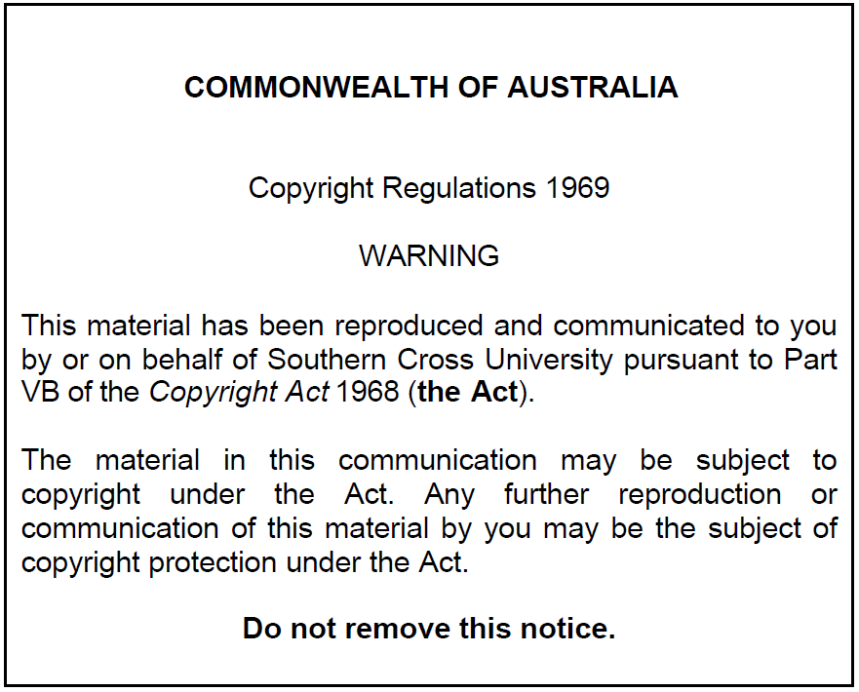

Slide 3
Specific objectives
  Name and explain the actions of the two types of steroidal hormones released from the adrenal cortex (glucocorticoids and mineralocorticoids – the androgens are not as important so concentrate on the first two).
  Using hypoglycaemia as the stressor explain why the ‘hypothalamus > anterior pituitary > adrenal cortex’ axis is considered the stress axis (in other words, how does this axis help out in hypoglycaemia?)
  Using dehydration or hypovolemic shock as the stressor explain why the ‘hypothalamus > anterior pituitary > adrenal cortex’ axis is considered the stress axis (How does the adrenal gland help in times of dehydration?) Drugs to know: Spironolactone and Fludrocortisone
  Detail the physiological actions of the glucocorticoids. Give specific examples of the application of glucocorticoids in pharmacology, using specific drugs as examples (Methylprednisolone, Prednisolone and Dexamethasone). List ten specific adverse effects of glucocorticoids.

Slide 4
PHAR2001_2_5_1
kjhkjhlkdfs
Medications of the Endocrine System: The adrenal cortex:
Lesson 1
Overview of the stress axis and mineralocorticoids

Slide 5
‘Corticosteroids’
  Steroidal hormones secreted by the adrenal cortex
  They include:
Glucocorticoids
Save glucose
  Mineralocorticoids
  Save salt
  NOTE: In clinic, you may refer to ‘corticosteroids’ as being synonymous with the pharmaceutical glucocorticoids like prednisone
Note: Androgens like testosterone are secreted by the adrenal cortex as well but they are never referred to as corticosteroids – they are sex hormones

Slide 6
Overview
What is meant when a person says “I have had to be on steroids”?
Corticosteroids are steroidal hormones secreted by the adrenal cortex. They include:
Glucocorticoids and Mineralocorticoids
Anabolic steroids are testosterone and its ‘analogues’ (similar in structure)
  A person would not say they are on anabolic steroids

Slide 7
Overview
What is meant when a person says “I have had to be on steroids”?
Corticosteroids are steroidal hormones secreted by the adrenal cortex. They include:
Glucocorticoids and Mineralocorticoids
The glucocorticoids include cortisol, the major stress hormone
‘Glucocorticoids’ refers to cortisol and similar
‘Cortisol’ is the most abundant glucocorticoid
Prednisone and prednisolone are medications that act like cortisol
  Taken to decrease the immune system response (asthma, autoimmune disorders, organ transplant…)
Anabolic steroids are testosterone and its ‘analogues’ (similar in structure)
  A person would not say they are on anabolic steroids

Slide 8
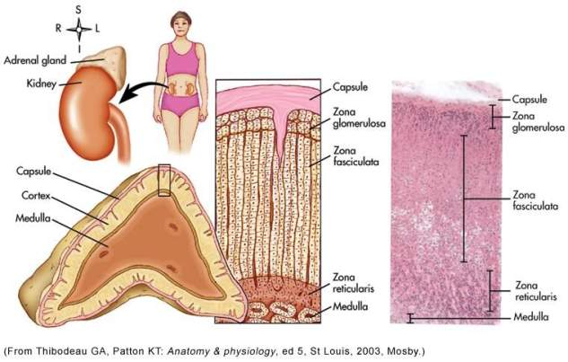
Adrenal Glands
Adrenal cortex
  80% of an adrenal gland’s total weight
    Synthesizes and releases steroid hormones called corticosteroids
Adrenal medulla
  Innervated by the sympathetic and parasympathetic nervous systems

Slide 9
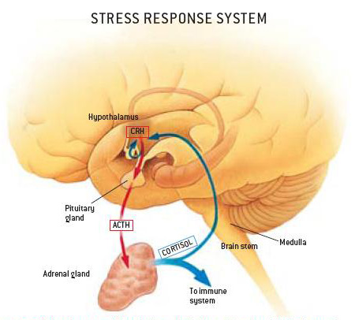
Glucocorticoids, mineral corticoids and noradrenaline are released from the adrenal gland in response to stress
Roberto Osti’s work portrayed
in the Scientific American

Slide 10
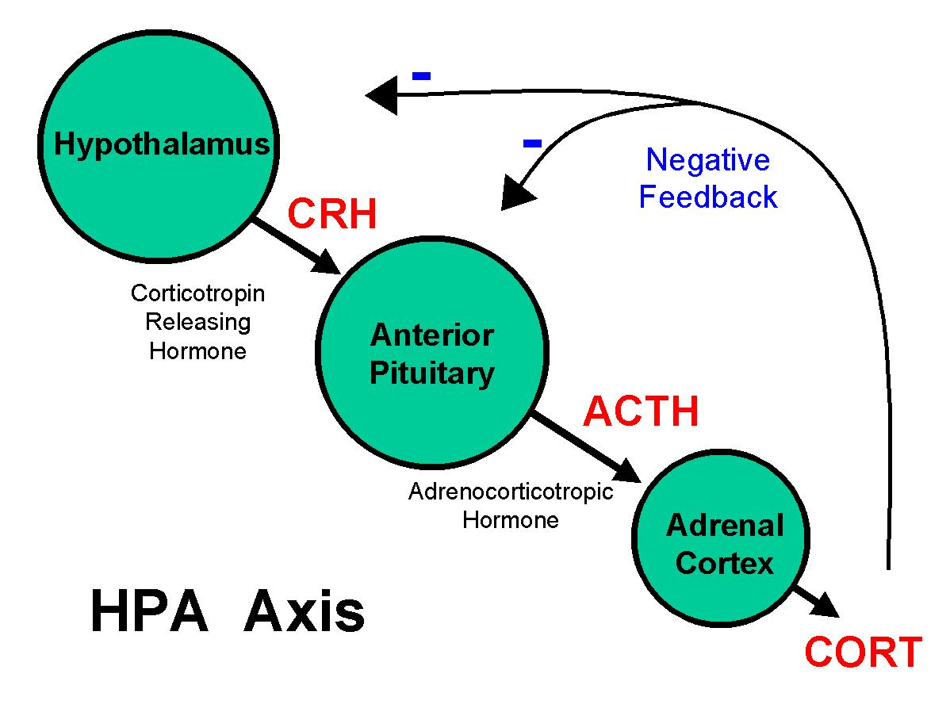
How the stress axis works
CRH released from the hypothalamus in response to:
  Stress
  Hypoglycemia
  Decreased circulating levels of glucocorticoids
Adrenocorticotropin hormone (ACTH) is released from the pituitary when stimulated by CRH, releasing
  Glucocorticoids,
  Mineralocorticoids (salt savers)
  Androgens
…From the adrenal cortex

Slide 11
PHAR2001_2_5_1
kjhkjhlkdfs
Medications of the Endocrine System: The adrenal cortex:
Lesson 2
Glucocorticoids

Slide 12
Effects of glucocorticoids
(Mainly cortisol; a steroidal hormone)
Cortisol is essential in times of trauma and stress:
  Affects glucose metabolism
  Stimulates gluconeogenesis
  Increases blood glucose
  Stimulating tissues to use free fatty acids for energy instead of glucose
  Stimulates protein breakdown
  Inhibits protein syntheses in all body cells
  Stimulates hunger
  Promotes fat buildup in the trunk and facial regions
  Increases the effects of catecholamines - increased heart rate / blood pressure
  Inhibition of the immunity and inflammatory
  Strong effect on emotional stability and mood.

Slide 13
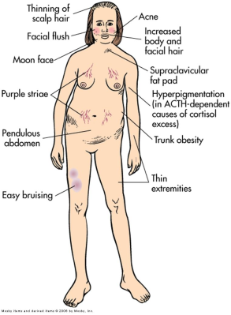
Mosby, 2006

Slide 14
PHAR2001_2_5_1
kjhkjhlkdfs
Medications of the Endocrine System: The adrenal cortex
Lesson 3
Understanding the side effects of corticosteroids

Slide 15
Alterations in adrenal function
Disorders of the adrenal cortex
  Cushing disease
    Excessive anterior pituitary secretion of ACTH
  Cushing syndrome
    Excessive level of cortisol, regardless of cause
    Iatrogenic Cushing’s syndrome can occur with corticosteroid treatment

Slide 16
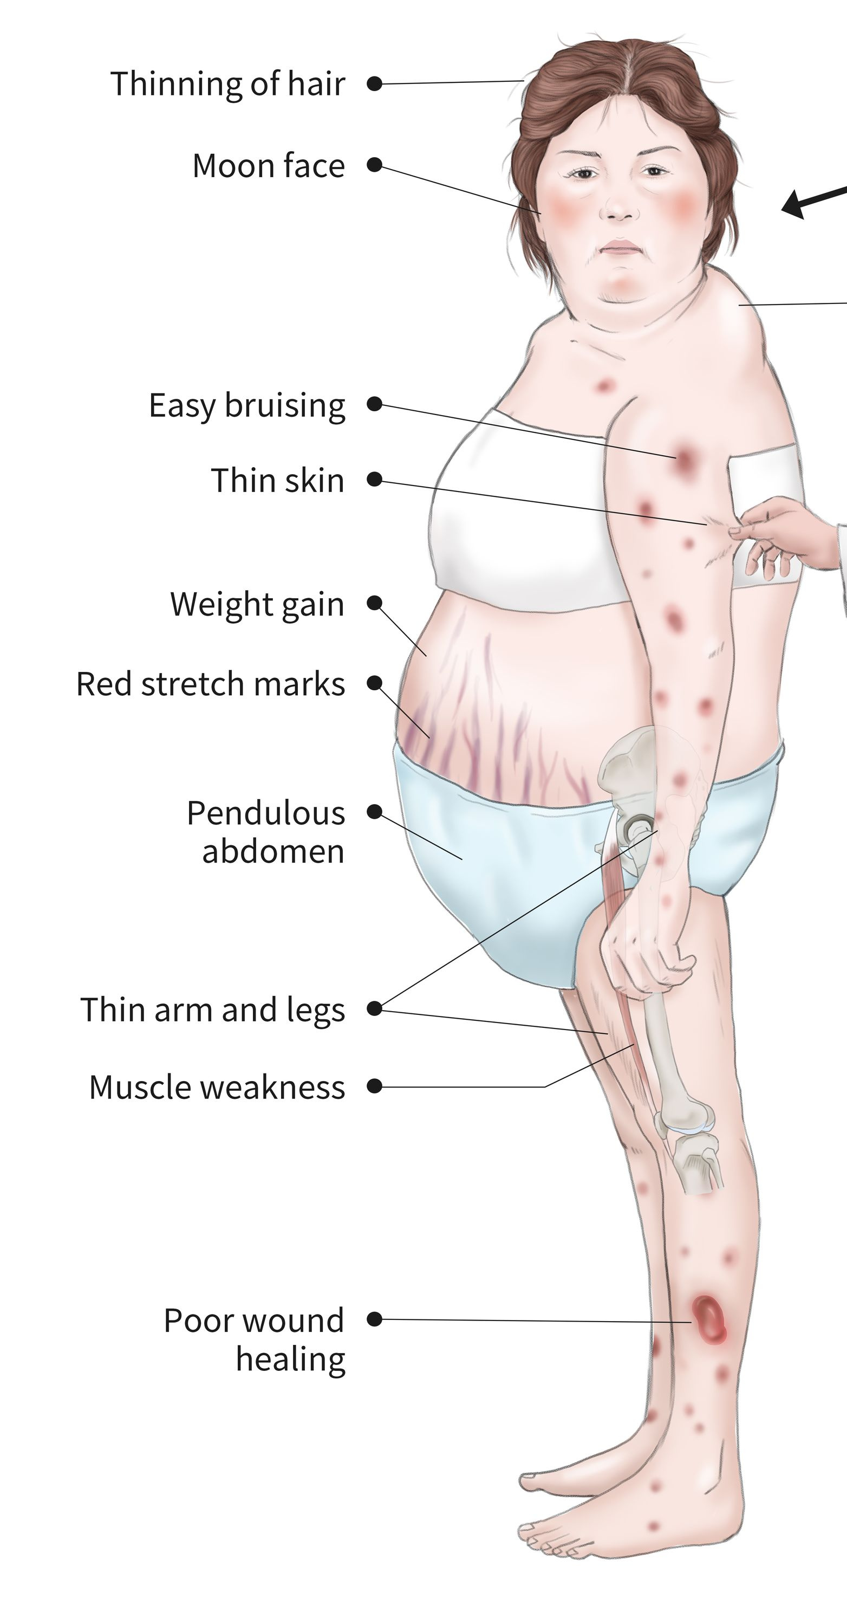
Clinical manifestations of Cushing’s
Altered fat metabolism leading to fat pads on the back, moon face, protruding abdomen with thin extremities, stretch marks on breasts, thighs, and abdominal surface.
Muscle weakness from protein breakdown
Hypertension as a result of increased catecholamine responsiveness
Weight gain resulting from strong appetite stimulation. Because of effects on hepatic gluconeogenesis, a reversible form of diabetes mellitus may result.
Inhibition of immune and inflammatory reactions, leading to poor wound healing
Shutterstock image

Slide 17
Long term side effects of corticosteroids are the same as Cushing’s syndrome
Altered fat metabolism leading to fat pads on the back, moon face, protruding abdomen with thin extremities, stretch marks on breasts, thighs, and abdominal surface.
Muscle weakness from protein breakdown
Hypertension as a result of increased catecholamine responsiveness
Weight gain resulting from strong appetite stimulation. Because of effects on hepatic gluconeogenesis, a reversible form of diabetes mellitus may result.
Inhibition of immune and inflammatory reactions, leading to poor wound healing
Shutterstock image

Slide 18
Adrenal dysfunction after long term corticosteroid treatment
Secondary adrenal insufficiency - hypopituitarism / hypothalamic dysfunction
ACTH is not released
Lack of mostly glucocorticoids, but possibly also androgens and mineralocorticoids
This can occur if cortisol treatment is withdrawn suddenly

Slide 20
Clinical manifestations of
secondary adrenal insufficiency
Following sudden withdrawal from corticosteroid treatment, the client may experience:
Depression
  (because cortisol levels influence mood and emotions)
Fatigue,
  (related to hypoglycemia, and decreased gluconeogenesis)
Anorexia, vomiting, diarrhea, and nausea
Inability to respond to stressful situations
  (perhaps leading to severe hypotension and shock)

Slide 21
Specific glucocorticoid medications
Prednisolone is a synthetic derivative of cortisol
  Used to treat inflammatory and auto-immune system conditions
  Active metabolite of prednisone
  Used with people who cannot metabolise prednisone
    Liver failure

Slide 22
Adrenal cortex antagonists
Spironolactone
  Antagonist to the mineralocorticoid aldosterone
  Anti-salt saver (a diuretic)
  (to be discussed at a later time)

Slide 23
Review: Adrenocortical hormones and their effects
Hormone
Mineralocorticoids
  Aldosterone.
    Fludrocortisone
  Aldosterone antagonist
    Spironolactone
Glucocorticoids
  Cortisone, hydrocortisone
    Methylprednisolone
    Prednisolone
    Dexamethasone
Effect
Sodium and water retention
Increase blood glucose
Regulate immune/inflammatory response
Stimulate protein catabolism

Slide 24
References
Thibodeau GA, Patton KT: Anatomy and Physiology 5th ed. Mosby, St. Louis 2003
Osti R: The Scientific American https://www.scientificamerican.com/article/illustrations-of-roberto-osti/
Patton KT, Thibodeau GA: Mosby’s Handbook of Anatomy and Physiology Mosby, St. Louis 2006
Royalty free images from Shutterstock
The PowerPoint and associated Video were edited and produced by Dr. Ken Wojcikowski

